Slide 1
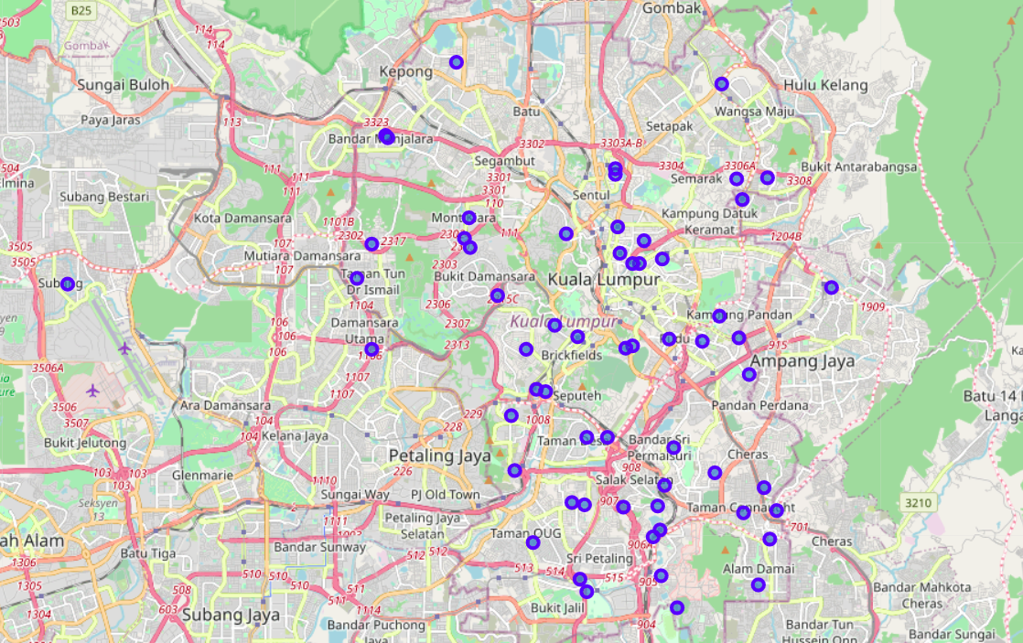
The battle of neighbourhoods – kuala lumpur
Applied data science capstone project
By
Wk Ng

Slide 2
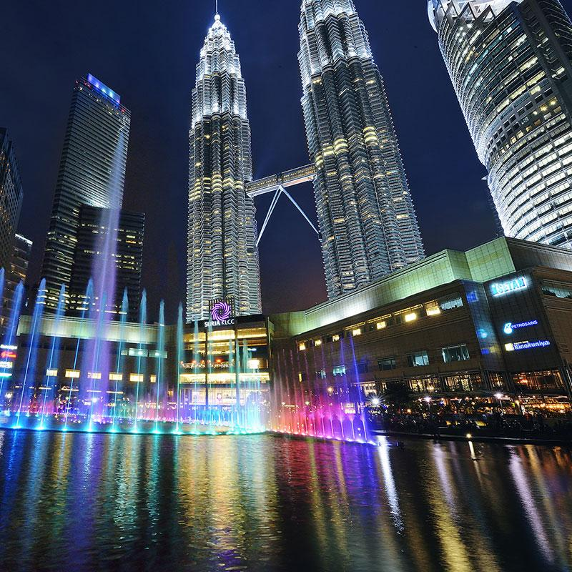
Introduction: problem description
As one of the developing countries in the Asia Pacific region, Malaysia is well known for its blooming travelling industry. In 2019, the capital state of Malaysia, which is Kuala Lumpur, ranked 10th in destination popularity worldwide for tourists, with an approximate amount of 14.07 million tourists arriving. In the same year, Malaysia also ranked 22nd in worldwide tourism popularity with a total of 26 million tourists visiting the country.
The high popularity amongst tourists and backpackers eventually resulted in the rise of hotels and hostels in Kuala Lumpur. In 2019, there were a total amount of 4,826 of hotels in the capital state. With the increasing amount of hotels, it was expected there will be more people who are interested in starting a hotel. This project is mainly aimed to help owners to find the optimal location for business, which includes analysis such as:
What is the best location to start a new hotel in Kuala Lumpur?
Which area has more facilities around?

Slide 3
Data Requirements
A list of KL districts, with their postcodes
Source (Credits to zaephaer): https://github.com/zaephaer/CapstoneProject/blob/master/KL_disrict.csv
Foursquare API, to locate the longitude and latitude of the areas, as well as listing the name and category of each area
Source: https://foursquare.com/developers/apps
Geocoder package, to track down the longitude and latitude of the areas

Slide 4
Methodology
The dataset provided consists of 66 areas and had been classified into 11 districts. By using APIs such as PositionStack, we are able to obtain the longitude and latitude of the areas in Kuala Lumpur.
By using Foursquare API, we are able to determine the most popular venues in each areas. 2001 venues are detected, being classified into 262 unique categories.
After performing one hot encoding on the dataset, we obtain the 10 most common venue category in each area. Clustering is then performed for K-Nearest Neighbor clustering. Elbow method is conducted beforehand to gain the optimal value of k (5).
Through the clusters on the map, we are able to analyze and determine the major business types in each city, hence determining the best place to start a hotel business.

Slide 5
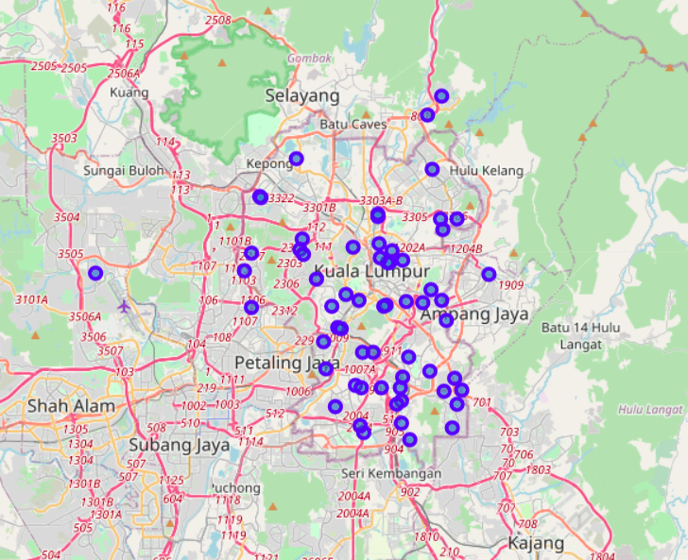
Map of Kuala Lumpur (Before Clustering)

Slide 6
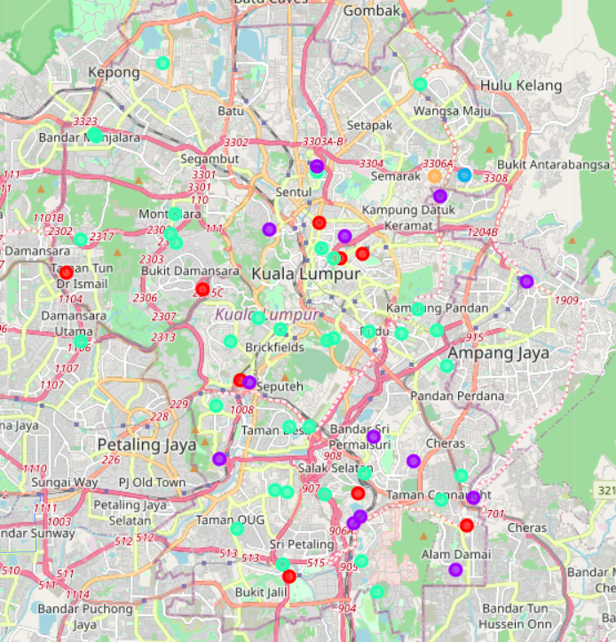
Map of Kuala Lumpur (After Clustering)

Slide 7
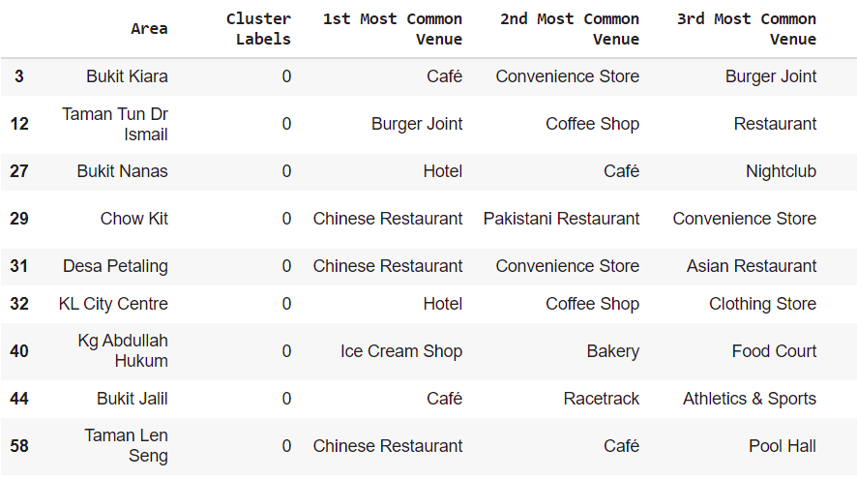
Top 3 venues of cluster 0

Slide 8
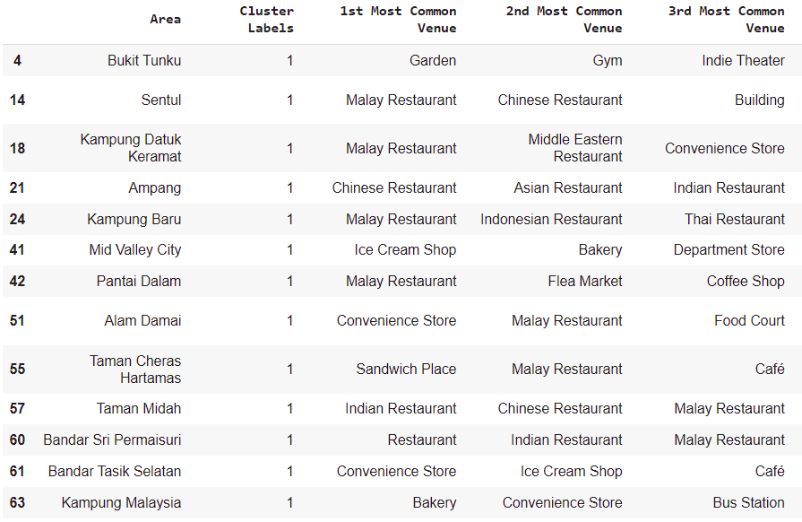
Top 3 venues of cluster 1

Slide 9
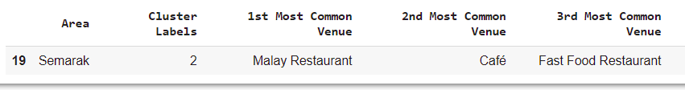
Top 3 Venues of Cluster 2

Slide 10
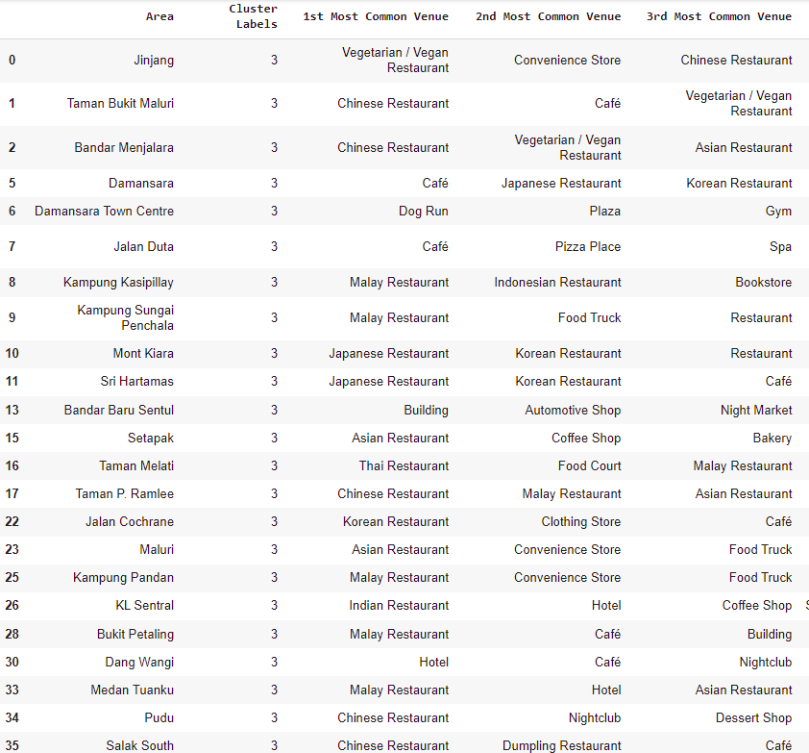
Top 3 Venues of Cluster 3 (Part 1)

Slide 11
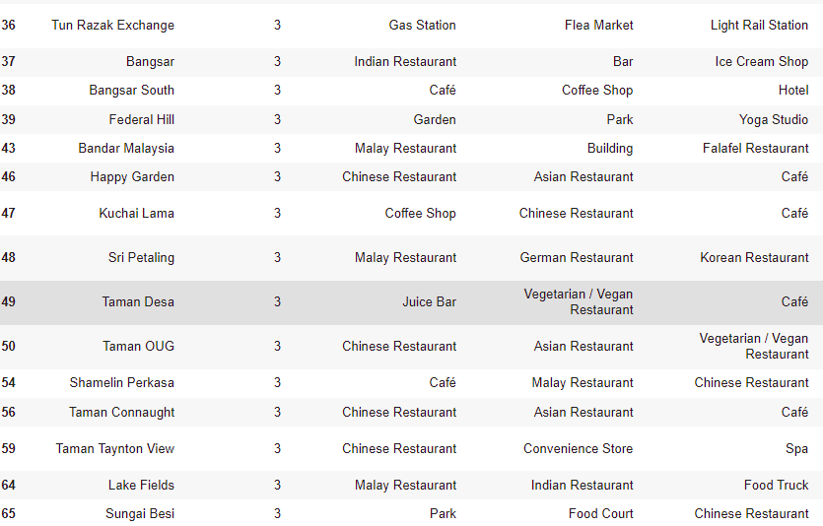
Top 3 Venues of Cluster 3 (Part 2)

Slide 12

Top 3 Venues Of Cluster 4

Slide 13
Observations
1. Hotels are mostly located in Cluster 0, 1 and 3. However, cluster 3 has 4 areas with hotels as the top 3 most common venue (KL Sentral, Dang Wangi, Medan Tuanku, Bangsar South), making Cluster 3 the most popular place the set up a hotel. Cluster 0, however, has the 2nd highest popularity with 2 areas having hotels as the most common venue (Bukit Nanas and KL City Center).
2. For the 2 areas in Cluster 0 which has hotel as their most popular venue (Bukit Nanas and KL City Center), both areas have food related shops nearby (Examples: Restaurant, Bar, Lounge)
3. The food industry is shown to be really popular in Kuala Lumpur, as a majority of the areas have either a restaurant or a food related shop as their most common venue. Most of the restaurants, however, are popular in Cluster 3, with a majority of areas having restaurants as their most popular venue.
4. Cluster 0 is also famous for their sports facilities, with places such as soccer stadiums and racetrack being listed as some of the most common venues.

Slide 14
Conclusion
After the analysis above, despite the high popularity in Cluster 3, it is deduced that areas in Cluster 1 is the most suitable to open a new hotel. This is due to it's above average popularity in tourism with two areas listing hotels as their most common venues (Bukit Nanas and KL City Center). Despite having the most amount of hotels, Cluster 3 may not be the best option as there could be too many competitions around the area. Cluster 0 was also surrounded with a variety of multinational restaurants, giving tourists a variety of choices when it comes to food.

Slide 15
Drawbacks
Despite the conclusion being made, a few suggestions are provided to further increase the accuracy of the analysis. Firstly, the amount of areas need to be reduced into a smaller amount. As an example, only the 2 districts with the most amount of areas (Segambut and Bukit Bintang) are analyzed to simplify the analysis process. Other factors, such as tourist hotspots, competitions and price must also be taken account to further analyze the suitability of the place.

Slide 16
Thank you!

